Slide 1
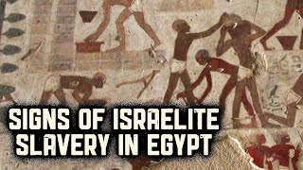
Exodus 2:23-25 出埃及記 二章23-25節
親子靈修 呂沈仁娣分享
08-09-2025
https://www.youtube.com/watch?v=lfQdjdSm2AE
Signs of Israelite Slavery in Egypt - The Exodus
Patterns Of Evidence
Jul 10, 2022
-- Patterns of Evidence Quick Links --
Time: 9:45

Slide 2
I、Bible Reading (NIV)-- Exodus 2:23-25
(Take turns reading either Chinese or English version)
字義解説摘自：ttps://cmcbiblereading.com/2015/03/02/出埃及记第2章逐节注解、祷读/
(https://www.biblegateway.com/passage/?search=Exodus%202%3A23-25&version=NIV) | https://thebiblesays.com/en/commentary/exo+2:23
23 During that long period, the king of Egypt died. The Israelites groaned in their slavery and cried out, and their cry for help because of their slavery went up to God. | -- In Acts 7:30, commentary Stephen states that the gap between verses 22 and 23 is 40 years. This would make Moses around 80 years old at this point, around 1486 B.C. -- The word for God is the name for the Creator-God (Elohim, Genesis 1:1 ) It is not the covenant name for God, which (as we shall see in chapter 3), is Yahweh (or simply YHWH). -- & the word God (Elohim) is used four times in describing His response.
24 God heard their groaning and he remembered his covenant with Abraham, with Isaac and with Jacob.
25 So God looked on the Israelites and was concerned about them.

Slide 3
I-1. 讀經: 與兒女輪流讀(中或英)
經文選自：香港聖經公會
https://rcuv.hkbs.org.hk/RCUV2/EXO/2:23-25/
字義解説摘自：https://cmcbiblereading.com/2015/03/02/出埃及记第2章逐节注解、祷读/
出埃及記 2章23-25 節 | 字詞/文意解説
23 過了許多年，埃及王死了。以色列人因做 苦工，就嘆息哀求；他們因苦工所發出的哀聲達於上帝。 | -- 「埃及王死了」, 可能是图特摩斯二世死了。王后哈特谢普苏特（Hatshepsut，主前1478–1458年在位）成为女法老；她未杀戮以色列男孩，却大规模建筑神庙，而奴役以色列人。以色列人原以为法老一死，情形会好转。但现在法老死了，没好转，希望全破灭了，才想起向神「叹息哀求」，「哀声达于神」。 -- 上帝 （the Creator-God (Elohim, 創1:1) ）這字在此用了四次！此處不是Yahweh (or simply YHWH) 這字。 -- -- 創造萬有的上帝始终掌管环境，祂「听见」、「记念」、「看顾」、「知道」一切（24-25节）。
24 上帝聽見他們的哀聲，就記念他與亞伯拉罕、以撒、雅各所立的約。
25 上帝看顧以色列人，上帝是知道的。

Slide 4

II. Film Watching Together– The Isralites --Slaves in Egypte 親子同賞影帶-- 以色列民 --在埃及為奴
https://www.youtube.com/watch?v=SziZkY48s1
IAncient Oppression: The Israelites Under Egyptian Rule
Jul 31, 2025 Time:13:44
Movie Resaps (for older kids)
Ancient Oppression: The Israelites Under Egyptian Rule
（不知何故，這影帶突然收不到了！)
https://www.youtube.com/watch?v=hnkFphM_KRM
Exodus 1: How the Israelites Became Slaves in Egypt - Bible Stories for Kids
Sep 12, 2024 / Time: 3:01
(for little ones)
Faith Tales

Slide 5
I-2. Guidelines For Brief Interaction (簡易互動原則）
Verses 24 - 25 describe God's response to the cries of His people.
In these two verses, the word God (Elohim) is used four times in describing His response.
(1) God heard their groaning.
(2) God remembered His covenant with Abraham, Isaac, and Jacob.
(3) God saw the sons of Israel. & (4)"God knew."
These actions of God ("hear", "remember", "see", "know") are indications of His faithfulness to His covenant people.
The rest of the book of Exodus is a record of His faithful action on behalf of His people.
(https://thebiblesays.com/en/commentary/exo+2:24-25)
Please do the following after read through the passage
(閲讀完經文后，請如此行)：
1. Briefly Clarify Unclear Points
簡單解釋不明字詞
2.Encourage Children Use Their Own Words To Tell The Story, the Scenario.
鼓勵兒女用自己的語言描述故事情境。
3. Or To Ask Whatever Questions Come To Their Mind.
或請兒女提出心中的疑問困擾;
4. Give a brief answer & follow up later.
簡要回答，隨後再跟進。

Slide 6
【出二25】「神看顾以色列人，也知道他们的苦情。」
神始终掌管环境，祂「听见」、「记念」、「看顾」、「知道」一切（24-25节）; 祂一面在旷野预备执行救赎计划的器皿，一面在埃及预备环境，要把祂的百姓带到「叹息哀求」的地步，在心思上愿意离开埃及。
神的工作并不是因以色列人的「叹息哀求」（23节）！神所要做的完全是根据祂的恩典、根据祂自己的救赎计划。就连「记念祂与亚伯拉罕、以撒、雅各所立的约」（24节），表面上是因着神的信实，实际上这约本身就是因着神的恩典。
神一直在等着听「他们的哀声」（24节）：「耶和华必然等候，要施恩给你们」（赛三十18），所以「他们尚未求告，我就应允；正说话的时候，我就垂听」（赛六十五24）。但人不但信心是残缺的，連「叹息哀求」（23节）也常不诚心，一旦环境变化，他们又会改变主意。
因此，人在救赎的过程中一点地位都没有，完全是神的恩典在那里做工。人唯一能做、當作的，就是用信心来配合神的工作。 （摘自：https://cmcbiblereading.com/2015/03/02/出埃及记第2章逐节注解、祷读/)

Slide 7

IV. Reflections–Parenting 教養反思 -- for young kids
問小可愛：如果他/她在家中與家人或在外與鄰居朋友之間，有些快樂或不快樂的事發生了，您認爲：爸媽會不會「听見」、「记念」、「看顾」、和「知道」呢？
爸媽如果知道別人對你不好了，通常會作什麽？而如果你對別人不好、或錯了什麽事？爸媽會知道嗎？爸媽又會做什麽呢？
所以，你覺得如果有什麽事發生，你可以如何幫助爸媽更快更早來照應你呢？
教 养
https://img.tukuppt.com/photo-big/09/32/86/3464e30470d467b3181.jpg
智
慧

Slide 8

IV. Reflections–Parenting 教養反思--for older kids
智
教 养
慧
（1）請您愛子分享，一個他/她記憶深刻：爸媽如何「听见」、「记念」、「看顾」、「知道」他或她在家或在外曾作的一件好事，或一件錯事。 而他/她可記得爸媽如何關心與處理那事嗎？爸媽所作的，帶給他/她什麽影響呢？
（2）鼓勵孩子思想：他/她現在手邊有沒有什麽自己無法解決的事情或人際關係？他/她可不可以告訴上帝，愛他/她的天父爸爸呢？他/她認爲，天父爸爸聽了以後會不會“紀念”、“看顧”、“幫助”呢？
（聆聽他/她分享、並與他/她一起禱告求告主！）
https://img.lovepik.com/photo/50772/0271.jpg_wh860.jpg

Slide 9
IV. Reflections–Personal 個人反思
請思想：
1）您可曾經歷生命中一些患難、困苦、沮喪、傷心或絕望嗎？那時候，您可曾到主的面前，尋求祂的安慰、支持與引領呢？祂曾如何垂聼並搭救您嗎？
2）思想：神伸手搭救的原因是什麽呢？是您的哭聲巨大？您的性情討喜？您所作感動了神？還是天父原本就深愛我們，且對您我滿了恩惠、慈愛與憐憫？？！！
个 人 反 思

Slide 10

V-1. Closing Prayer 結束禱告
https://www.shutterstock.com/image-photo/christian-family-praying-together-concept-600nw-2291128441.jpg
Abba Father God! You are the Creator and Sovereign of all things! Though you sit high in heaven, you are ever present in our lives. You always "hear," always "remember," watch over, and know everything (verses 24-25)! You know everything I think, love, do, and say. You know it all! Please watch over me, guide me, and lead me to always walk in your presence!
阿爸父神啊！您是創造且掌管萬有的主！您雖高坐在天，但您卻隨時臨在我們的生命與生活中。您時時「听见」、常常「记念」、處處「看顾」、樣樣「知道」（24-25节）！您知道我所思所想、所愛所作、所說所言。您都知曉！求您眷顧、引領、牽我時刻行在您面光中！

Slide 11

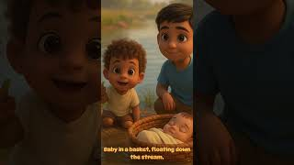
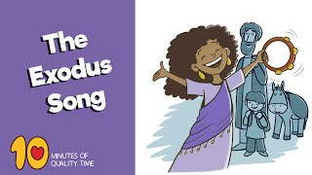

V-2. Closing Song 結束詩歌
https://www.youtube.com/watch?v=1L_IaH8hyew
Catchy Christian Song for Kids and Toddlers | The Exodus Song!
Eliara Kids – Bible So -- for little ones
Jun 9, 2025/ Time: 052
https://www.youtube.com/watch?v=ElPzz1jmKqk
The Exodus Song - Bible Songs for Kids
10 Minutes of Quality
May 8, 2023 / Time: 2:41
https://www.youtube.com/watch?v=itHwEye_Hvc
Exodus (Theme from Exodus /
The Exodus Song) Steven Sterling
Apr 23, 2020 / Time: 3:18

Slide 12
MORE。。。。。。

Slide 13
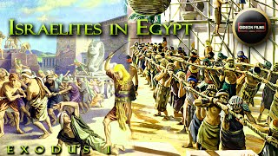
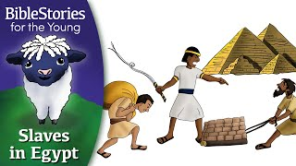
MORE。。。。。。
Film Watching – The Story of Moses（Kids alone or With Parents)
獎勵影帶 – 摩西的故事 （兒女單獨看或父母同觀賞）
More ... for children & Parents
https://www.youtube.com/watch?v=PLvCijzJjXU Day 31 God's Children: Slaves in Egypt ~ Daily Bible Stories for Children & Learners (for little ones) Jan 30, 2022 Time 3:26 Pharaoh tries to weaken God's children through slavery and hard work, but they multiply and grow stronger. | https://www.youtube.com/watch?v=qk4UoM1Bjt4 Israelites Slavery in Egypt | Exodus 1 | Israelites Oppressed | pharaoh ordered babies killed (for older ones) Oct 22, 2023 ， Time：3：22 GIDEON FILMS

Slide 14

More。。。。 恩言慧語-- For parents
Recommended Reading：
https://godwardlife.org/blog/the-god-who-sees-and-responds
The God Who Sees and Responds
(Exodus 2:23–25).
https://www.youtube.com/watch?v=_kl-OIXTHzk
【走出苦情的陰霾】出埃及記2章23-25節 | 羅遠平牧師 | 六塊厝循理會
一、神垂聼哀哭的呼求
二、神紀念賜福的立約
三、神深知你底心苦楚

Slide 15
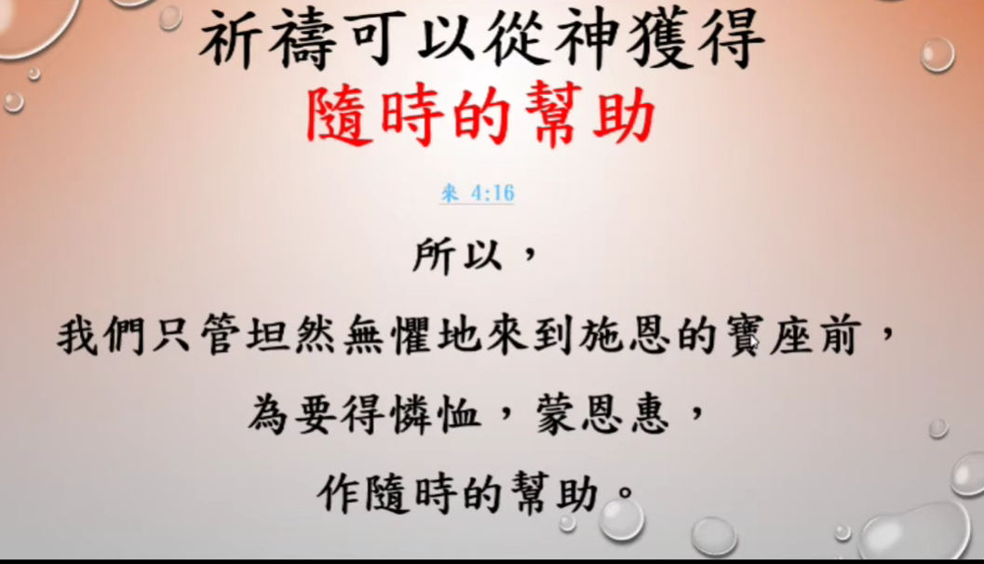
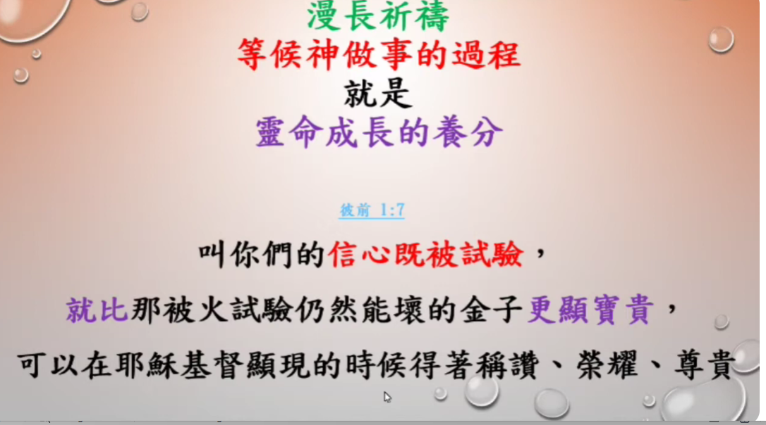
https://www.youtube.com/watch?v=AZvDoqyaPb0
出埃及記 14 出 2章 23- 25節 Jul 17, 2018
【走出苦情的陰霾】出埃及記2章23-25節 | 羅遠平牧師 | 六塊厝循理會

